Slide 1
OMS “Users’ Guide” Training •Federal and State Regulatory Roles in Transmission and Wholesale Markets •Why State Regulators Should Pay Attention to Wholesale Markets •The Organization of MISO States – How It Works and How You Can Participate
Bill Smith
July 12, 2011
Missouri Public Service Commission

Slide 2
FERC’s Wholesale Jurisdiction
Federal Power Act, § 201 (16 USC 824):
(b) (1) The provisions of this subchapter shall apply to the transmission of electric energy in interstate commerce and to the sale of electric energy at wholesale in interstate commerce [. . . ].
(c) Electric energy in interstate commerce For the purpose of this subchapter, electric energy shall be held to be transmitted in interstate commerce if transmitted from a State and consumed at any point outside thereof; but only insofar as such transmission takes place within the United States.
(d) “Sale of electric energy at wholesale” defined The term “sale of electric energy at wholesale” when used in this subchapter, means a sale of electric energy to any person for resale.

Slide 3
Federal Regulatory Issues
Wholesale markets
RTO areas = centralized regional markets
Non-RTO areas = bilateral markets
Regional Planning under FERC Order No. 890:
Open process
Competitive neutrality
Renewable resources for regional needs
Operational issues
Lake Erie loop flows
MISO v. PJM market error
Non-member transmission agreements
3
Notes:
Issues deal with
Wholesale sales
Transmission service
Backstop siting
States can and should advise FERC on these issues

Slide 4
Review of State Regulatory Role
Broad responsibility for retail markets – sales to end users
Retail rates
(except cooperatives and municipal utilities in most states)
Electric service facilities – permitting and siting of generation and transmission facilities
Need
Cost
Location
Includes Distribution, Transmission, Generation, Service Issues, and Safety
Notes:
Commission acts as buyers’ agent
See reference slide on contracts

Slide 5
Typical Retail Regulatory Issues – Traditionally Regulated State
Market structure
Portfolio Decisions
Resource and Transmission Planning
Renewable Portfolio Standards
Purchase Contracts
PURPA and Feed-in Tariffs
Demand Response; aggregation
Smart Grid, Metering and Net Metering
Service Area Boundaries
Permits, Siting, Certificates of Need
Notes:
See reference slide on types of states in OMS. Some are hybrid states.

Slide 6
Typical Retail Regulatory Issues – Retail Choice States
Seller qualifications
Customer service complaints
Seller inventory and supply adequacy
Provider of last resort
Transition – rate freezes
Procurement auctions
Market monitoring and mitigation
Notes:
Illinois holds auctions to procure electric supply.

Slide 7
How Regional and Wholesale Markets Affect State Regulatory Responsibilities
States must understand the wholesale markets available to them to design a retail market structure
Many states (but not all) approve changes in RTO membership or participation
States must understand the wholesale markets in which their utilities operate in order to understand decisions utilities must make in their wholesale market activities
States can use the Midwest ISO stakeholder process to advocate ways to shape the wholesale market for the benefit of the state’s residents and businesses
Notes:
The choice of market structure within a state may be made by legislature. Regulators are usually asked to advise, because the result must be one they can administer.
Membership issues – examples: Duke, First Energy, Entergy.
- When regulators do not have membership control (via jurisdiction over transmission owner), it may be a source of problems.
Utilities decide questions like self-scheduling v. market reliance; states can evaluate these decisions either before or after the fact.
Involvement in stakeholder process helps build this understanding – but states may disagree on how much involvement is right.

Slide 8
How Regional and Wholesale Markets Affect State Regulatory Responsibilities - More
States decide value of reliability
States determine adequacy of supply for future usage levels
States make land use decisions for new facilities
Balancing cost, need, and other land uses
Bring public policy into these decisions
May use criteria broader than the state
May use other political criteria
Notes:
With the advent of NERC, states can at least decide if they want higher levels of reliability than NERC standards. Also consider distribution issues like buried lines and transformers.
There is jurisdictional uncertainty about supply adequacy in an RTO construct. There seems to be some agreement that it is better to have RTO benefits and live with jurisdictional ambiguity than to forego clear and present benefits for theoretical clarity.
Think about new facilities for generation, transmission, and distribution.

Slide 9
Reference Section
Examples of states in MISO with:
Retail choice (IL, MI, OH)
Transmission spun off (IA, MI, MN, WI)
Generation spun off (IL, MT)
Multi RTO (IL, IN, MI, MO, OH)
Vertically integrated (IN, WI, MN, MI, IA, MO, ND, SD)

Slide 10
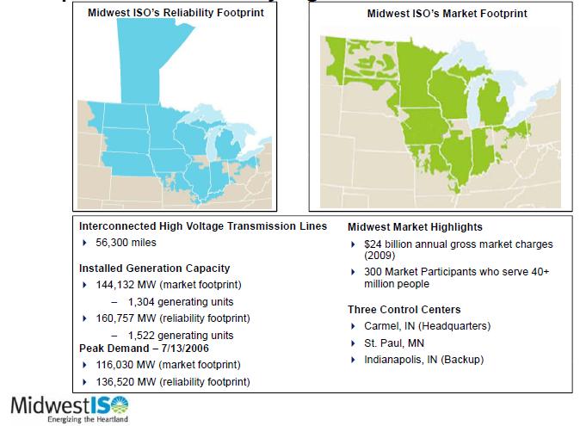
OMS Organization
MISO Footprints
Matches MISO footprint:s
13 state members and Manitoba
Board of Directors has 14 members
One from each member agency
Executive Committee is composed of 5 members
Includes the 3 members of the MISO Advisory Committee representing the State Regulatory Authorities sector
Notes:
Reliability footprint

Slide 11
OMS Membership
Membership is open to state regulatory authorities:
That regulate retail electricity or distribution rates of transmission-owning MISO members or transmission-dependent MISO members
That have primary siting authority
Associate membership open to other state agencies

Slide 12
OMS’s Objective: Multi-state Cooperation
Combined input to FERC when possible
Coordinated participation in MISO Stakeholder process
Facilitate participation and fund travel
Share information, expertise, and analysis
Emphasis on regulators and siting agencies
Best skill set to deal with RTO and FERC issues
Not joint decisions
Not “another layer of regulation”

Slide 13
Funding of OMS
OMS is an Indiana not-for-profit corporation with 501(c)(4) tax exempt status
Funding agreement signed with MISO
Funding agreement includes statement of independence
Agreement provides for dispute resolution by FERC
Remittances are automatic
OMS budget is included in MISO budget
OMS budget for 2011: $752,500 (includes >$200,000 for contingencies)

Slide 14
Communications and Positions
Process modeled on NARUC:
The OMS Board assigns issues to work groups
Seven standing work groups formulate positions
Other work groups as needed
Commission staff members may volunteer for any groups
OMS Board adopts positions only with a majority of all members
Board discusses monthly MISO Advisory Committee agenda – A/C representatives are guided by membership views
Board meetings are open monthly conference calls
Executive Director is clearinghouse
Guided via Board-approved Bylaws and written policies

Slide 15
Seven Work Groups
Markets and Tariffs
Transmission Cost Allocation
Regional Planning
Demand Response and Technology
Resources
Governance and Budget
Modeling

Slide 16
Governance and Budget Work Group
Co-chairs: Burl Haar, Minnesota PUC and Gail Maly, Wisconsin PSC
Coverage:
MISO Strategic Plan
MISO Budgets
Officer Duties
Weight given to state input
Increased transparency

Slide 17
Markets and Tariffs
Co-chairs: Bill Bokram, Michigan PSC and Christine Ericson, Illinois CC
Coverage:
Market Design and Value (the other cost allocation)
Energy and Operating Reserves Markets
Market Monitoring and Mitigation Issues
Market integration of Renewable Generation
FTR, ARR and Transmission Rights Issues
Market seams with Adjoining Markets

Slide 18
Demand Response and Technology
Co-Chairs: April Paronish, Indiana OUCC and John Feit, Wisconsin PSC
Coverage:
Customer response to market conditions
Rules to participate in Midwest ISO markets
Retail demand response
Smart Grid

Slide 19
Regional Planning
Co-chairs: Jerry Lein, North Dakota PSC and Parveen Baig, Iowa UB
Coverage:
Midwest Transmission Expansion Plan (MTEP)
Other transmission studies
Minimum generation issues
Seasonal reviews
Interconnection Process
Reliability studies and planning

Slide 20
Resources
Co-chairs: Don Neumeyer, Wisconsin PSC and ???
Coverage:
Resource Adequacy (planning reserve requirements)
Loss of Load Expectation and Planning Reserve Margins
Resource Assessments
Price Responsive Demand
Demand Side Management
Energy Efficiency

Slide 21
Transmission Cost Allocation
Co-chairs: Randy Rismiller, Illinois CC and Dave Johnston, Indiana URC
Coverage:
Regional cost allocations and pricing under RECB 1, RECB 2, and MVP
Cross border cost allocations

Slide 22
Modeling
Co-chairs: Nick Bowden, Illinois CC and ??
Coverage:
Analytic support to other work groups on economic, engineering and forecasting models

Slide 23
OMS Filings
Include minority positions
Judicial model rather than legislative
List participating states in conclusion
Also identifies non-participating states
Non-participation may indicate unavailability of commissioners
Some states require formal internal approval to join a filing (IL, OH, MT)

Slide 24
OMS Lessons to Date
The OMS model builds technical analysis in state commission staff
Staff members gain knowledge of RTO operations and personnel
Participation builds state staff expertise on issues and networking resources
Combined resources/expertise more efficient
Travel reimbursement is key to participation
Policy decisions need commissioner input
Respect for policy differences
Notes:
By combining the resources and expertise of state commissioners and staff, we reach a more efficient means, and therefore less costly means of participating before the Midwest ISO and FERC as compared to each state on its own.
The Midwest ISO holds about 600 stakeholder meetings per year, so combining resources also provides a more efficient means of keeping track of the various stakeholder groups.

Slide 25
Participation Guide
OMS e-mail lists
MISO e-mail lists
https://www.midwestiso.org/StakeholderCenter/Pages/StakeholderCenter.aspx
Register for MISO meetings on web calendar
OMS travel request prior
http://www.misostates.org/OMSTravelApprovalRequestupdated16Feb2010.doc
OMS travel reimbursement after
http://www.misostates.org/Travel_Reimbursement_NEW_01_10.xls

Slide 26
The OMS Value Proposition
Efficiency of dealing with the states collectively
FERC
RTO
RTO members
The states get better attention from FERC and the RTO
States improve their expertise on issues and provide better analysis of issues

Slide 27
OMS Office Contacts
Staff: Bill Smith, Executive Director, bill@misostates.org
Julie Mitchell, Office Manager, julie@misostates.org
Amy Schmelzer, Assistant, amy@misostates.org
100 Court Avenue, Suite 315
Des Moines, Iowa 50309
Phone: 515-243-0742
Fax: 515-243-0746
Website: www.misostates.org

Slide 28
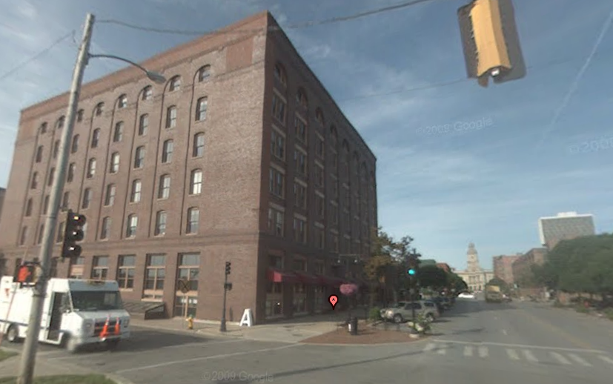
OMS Office

