Slide 1
Midwest ISO Stakeholder Process
Bill Smith
July 12, 2011
Missouri Public Service Commission

Slide 2
Midwest ISO Stakeholder Process
The Midwest ISO was formed almost 15 years ago by a “TO agreement” among its Transmission Owning members.
The Midwest ISO is a not-for-profit corporation. It is managed by its officers and a staff of about 600 employees, who are responsible to a Board of Directors.
The Board of Directors regularly meets six times a year via committee meetings and a full Board meeting.
The Board is elected by the members of the RTO, but must maintain FERC’s standards of independence from market participants and from RTO management.
The TO Agreement provides for participation of nine “industry sectors.”
The members of those sectors are referred to as stakeholders because they have business or policy interest in the operation of the Midwest ISO.

Slide 3
Sector | Seats
Transmission Owners | 3
Coordination Member | 1
Municipal and Cooperative Utilities / Other Transmission Dependent Utilities | 3
Independent Power Producers / Exempt Wholesale Generators | 3
Power Marketers/Brokers | 3
Eligible End-Use Customers | 3
State Regulatory Authorities | 3
Public Consumer Group | 2
Environmental/Other Stakeholder Groups | 2
Notes:
While SRA Sector is just 3 of 23 votes, other sectors are often aligned with OMS. The various state Consumer Advocates and Consumer Councils that are associate members of OMS vote in the Public Consumer Group Sector, while the regulatory commissions that are OMS Board members vote in the SRA Sector. For this reason, the SRA sector is often called “OMS” even though the associate members of OMS are not it this sector.

Slide 4
Midwest ISO Stakeholder Process - 2
The TO Agreement created the Advisory Committee as a forum where the stakeholders can give advice to the Board of Directors and the Midwest ISO officers and staff.
The Advisory Committee meets monthly.
There are 23 members of the committee, two or three from each of the nine industry sectors. Some may attend by telephone. Alternates and proxies are allowed to substitute for a member.
The OMS Vice-President, Secretary, and At-Large Member serve as Advisory Committee members for the State Regulatory Authorities sector.
The format of these meetings may include a “Hot Topic” question. Each industry sector may present a paper giving its views on that topic. The Board and officers discuss the presentations with the members.
The Advisory Committee also conducts other business, including reports from Midwest ISO management, from subcommittees, and from others.

Slide 5
Midwest ISO Stakeholder Process - 3
Midwest ISO’s “Meeting Week,” usually the third week of a month, includes the Advisory Committee meeting, the Board of Directors meeting, and Board committee meetings every other month.
Midwest ISO Committee meetings follow Robert’s Rules of Order and the Midwest ISO Governance Guide: https://www.midwestiso.org/Library/Repository/Meeting%20Material/Stakeholder/Governance%20Guide%20Approved%2020100818.pdf
Other stakeholder committees are held throughout the month, often on fixed days (i.e. “first Tuesday).”
There are about 30 stakeholder groups, all led by stakeholders. See https://www.midwestiso.org/StakeholderCenter/CommitteesWorkGroupsTaskForces/Pages/CommitteesWorkGroupsTaskForces.aspx
Their work is coordinated by a steering committee.
Notes:
About 600 stakeholder meetings per year

Slide 6
Midwest ISO Stakeholder Process - 4
Any member of the Midwest ISO or regulatory can participate in other subcommittee, working group, or task force meetings and propose and vote on proposals.
Participating in lower entities provides a better opportunity to propose direction and content of changes.

Slide 7
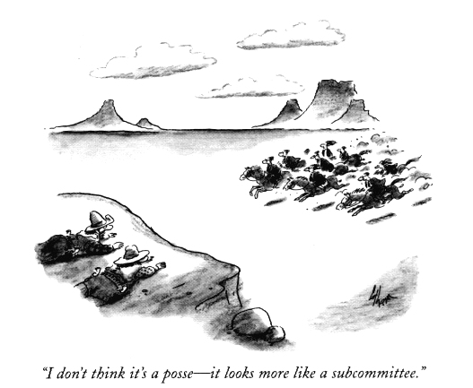
Questions?

Slide 8
Reference Section–Service Contracts
Very short (5-7 pages) two-party contract
Is a “blank check” that FERC fills in
“Service under this Agreement …will be determined in accordance with the terms and conditions of the Tariff.”
FERC approved tariff (>4,200 pages)
Modules A-F, Schedules 1-36 (49), Attachments (56), Rate Schedules 1-30 (24)

Slide 9
Reference Section–TO Agreement
Transmission Owners Agreement
Rate Schedule 1 (188 pgs)
Spells out structure of Midwest ISO
Binds transmission owners to Midwest ISO
Defers to FERC
“In the event of a conflict between this Agreement, including any appendices, and the Tariff, the Tariff shall prevail as the intent of the signatories.”
Notes:
The transmission owner is who joins the Midwest ISO. Membership is voluntary but once the TO Agreement is signed, the provisions and all of the FERC tariff is binding, including any exit fees.
In general, those served by the transmission belong in the RTO that the transmission owner does, so membership is not really voluntary for non TOs.

Slide 10
Reference Section–Other documents
Business Practices Manuals
Provides details on what Midwest ISO does
20 manuals (>3,200 pages)
Normal, Abnormal, Emergency Operating procedures
See Midwest ISO web site under Library
Notes:
When you want to know about something that the Midwest ISO does, start with the Business Practices Manuals instead of the tariff.
While there are about 40 different written procedures, the 4 emergency operating procedures are worth looking at, as they list the steps that the Midwest ISO takes during emergencies when resources are insufficient or overabundant, or when there is a transmission emergency.

