Slide 1
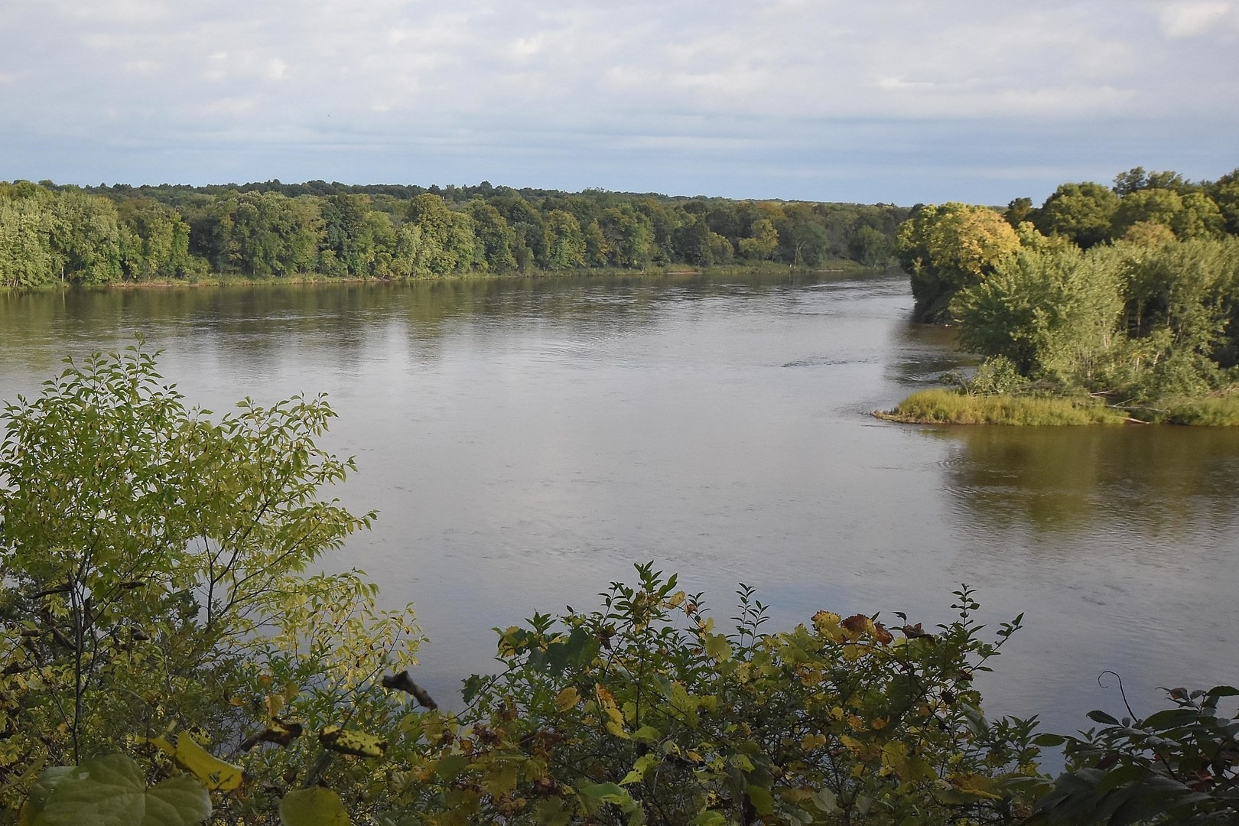


Slide 2
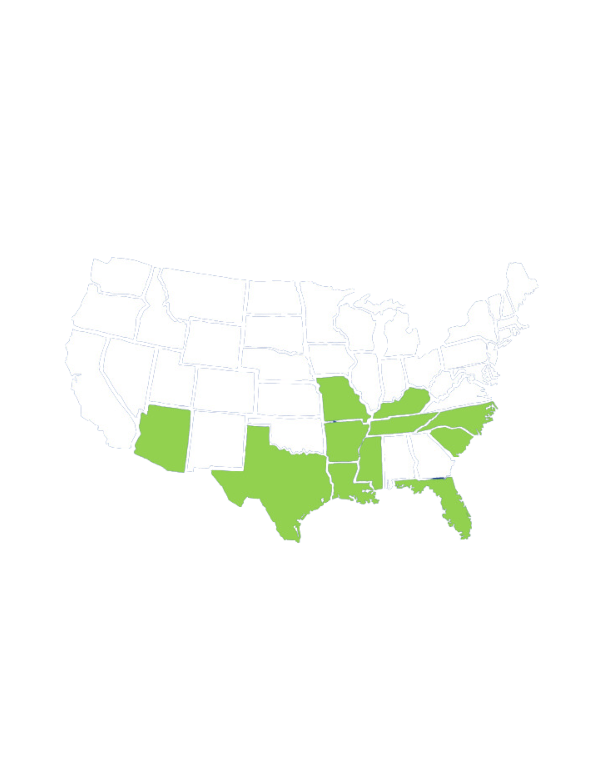

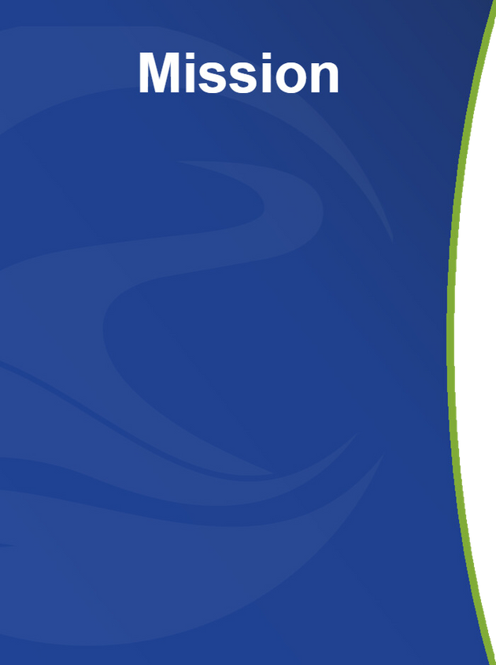
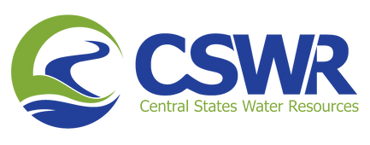

SAFE WATER, HEALTHY COMMUNITIES
  10th largest investor-owned water utility in the U.S.
  Largest owner/operator of individual domestic wastewater systems in the U.S.
  CSWR proudly serves over 300,000 people in 11 states including approximately 29,000 individuals in Missouri
  We have removed over 300 systems from compliance agreements with state environmental agencies.
CSWR OWNED SYSTEMS
Our mission is to bring safe, reliable and environmentally responsible water resources to every community in the U.S.

Slide 3



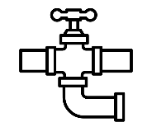



America’s Water Crisis
Industry fragmentation
There are ~48,600 drinking water utilities in the U.S. and more than ~23,500 sewer utilities
92% of U.S. water utilities cover small to very small communities; only 426 water utilities serve cities of 100,000 or more
Noncompliance
90,000 water or wastewater violations annually
  Utilities that serve less than 3,000 people hold ~70% of those violations
  1 in 4 Americans are exposed to potentially unsafe drinking water
  Over 40% of systems in the US are noncompliant with at least one water standard
New regulations for contaminants of emerging concern
Increasingly stringent federal water standards (e.g. PFAS regulation proposed in March 2023) enforcing contamination levels on PFAS, PFOS and other chemicals in the drinking water supply
  98% of all water utilities in the U.S. are not currently equipped to treat PFAS
  Implementing PFAS limits will require an estimated capital spend of $3.8bn
Consistency and resiliency
Climate variability is contributing to water scarcity issues and increased storm activity
Increased occurrences of cyber attacks pose a threat to the safety and reliability of water infrastructure

Slide 4
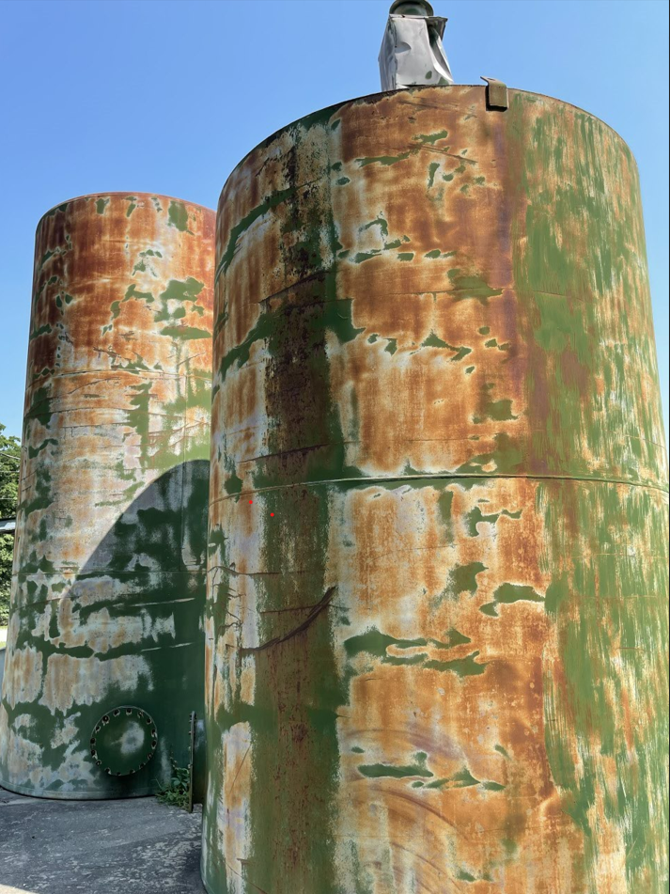
State of Infrastructure – Missouri
  Of the 4,513 community-based water systems in Missouri, approximately 2,800 have experienced non-compliance in the last 3 years
  Data from the Department of Natural Resources (DNR) shows that almost 71% of all wastewater systems in Missouri have been in a state of non-compliance one or more times over the last three years

Slide 5
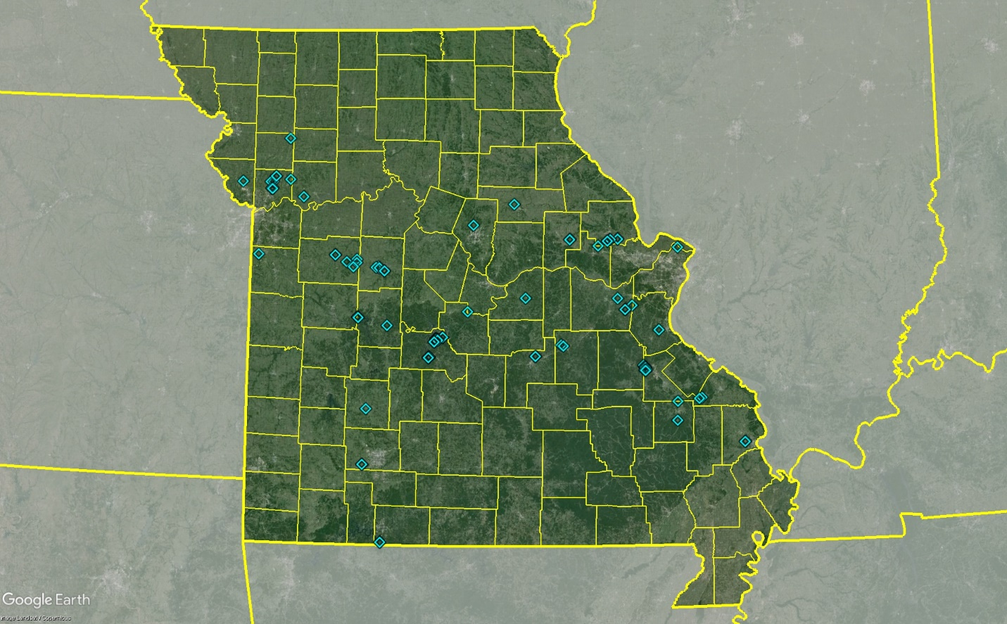
Confluence River’s Footprint

Slide 6

How We Serve Our Customers

Slide 7


Healthy Communities
  We are a dedicated team of 89 full-time personnel serving over 300,000 people.
    Serving approximately 29,000 people in Missouri
  Our connection of service isn’t just to an account, but to a human being, a family, a home or a business.
  We believe we have a responsibility to help our customers be as educated about the safety, reliability and costs of water and wastewater as possible.
  Our promise begins and ends with reliability — safe and reliable water, 365 days a year.

Slide 8
Confluence Rivers Customer Service - Metrics
  In Q1 2024, almost half of the 5,787 Confluence Rivers customers who called our Call Center chose to self-serve via the IVR
  In the most recent week of data, of the customers who chose to take a survey regarding their call center experience, the percentage of customers who stated that they were satisfied with their interaction was:
  100%
  Top 3 Reasons Customers Call Great River Customer Service:
    Pay their Bill
    Billing/Payment Inquiry
    Start or Stop Service

Slide 9
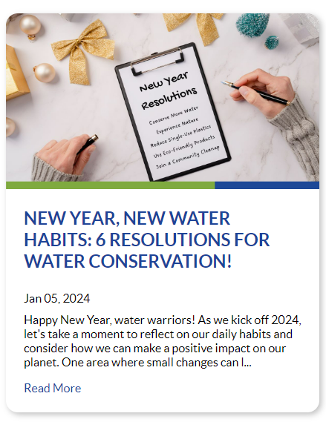
Staying Connected
  We go beyond what is required by regulation and focus on supporting our customers’ interests and needs.
  Consistent, transparent conversations are essential. We use tools like in-person conversations, direct mail, email, Facebook, Twitter, LinkedIn, 24-hour phone availability, our blog and more.
  Customers can now receive advisory notices by text and email – advisories are posted in both English and Spanish
  We‘ve expanded our payment options to include pay-in-person with over 30,000 locations nationwide. Customers can also pay online, by mail, and phone.

Slide 10
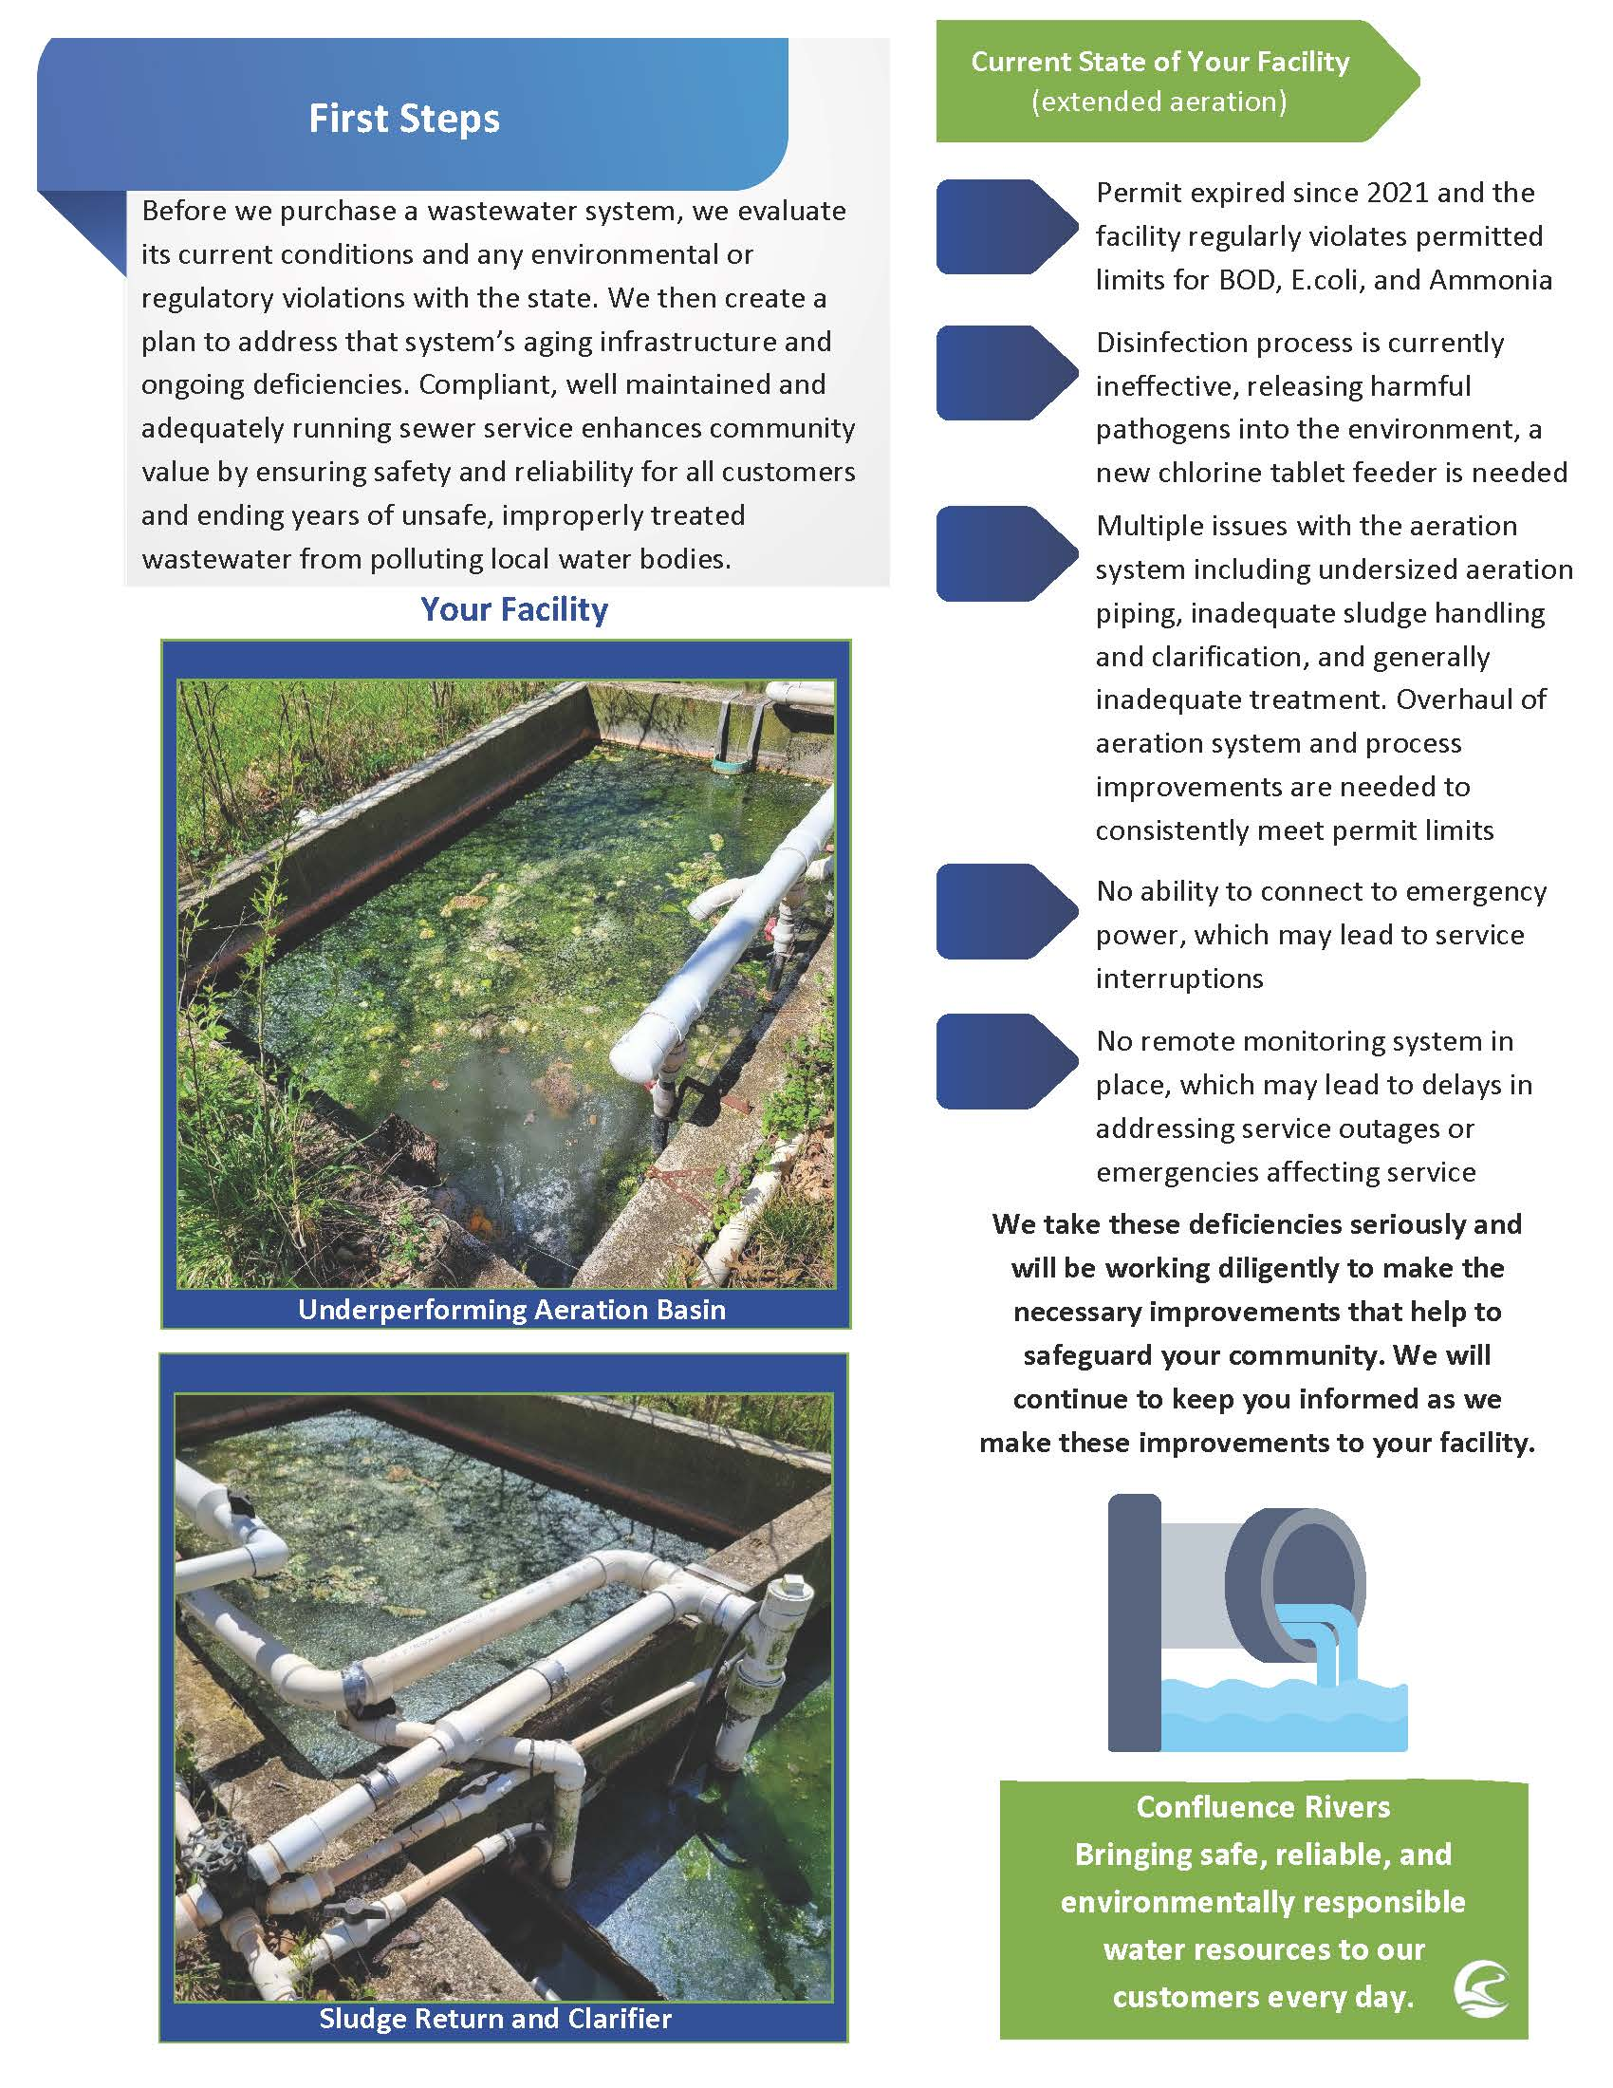
Staying Connected – Community Updates
  Launched a campaign to update customer data for communications
  Updated Welcome Letters to better educate customers on the condition of their system upon acquisition
  Launched surveys designed to capture customer satisfaction with both live representatives and IVR

Slide 11
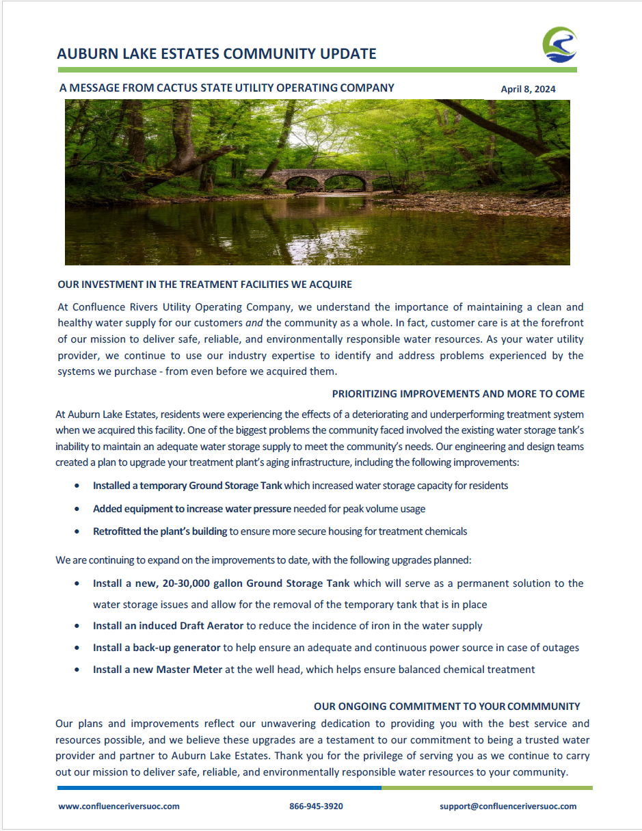
Staying Connected – Annual Updates
  Learning from Local Public Hearings: Water is Local
  Began providing Annual Updates (at a minimum) to each individual community served in Missouri
  Continue providing community signage during a construction project and community updates upon project completion

Slide 12
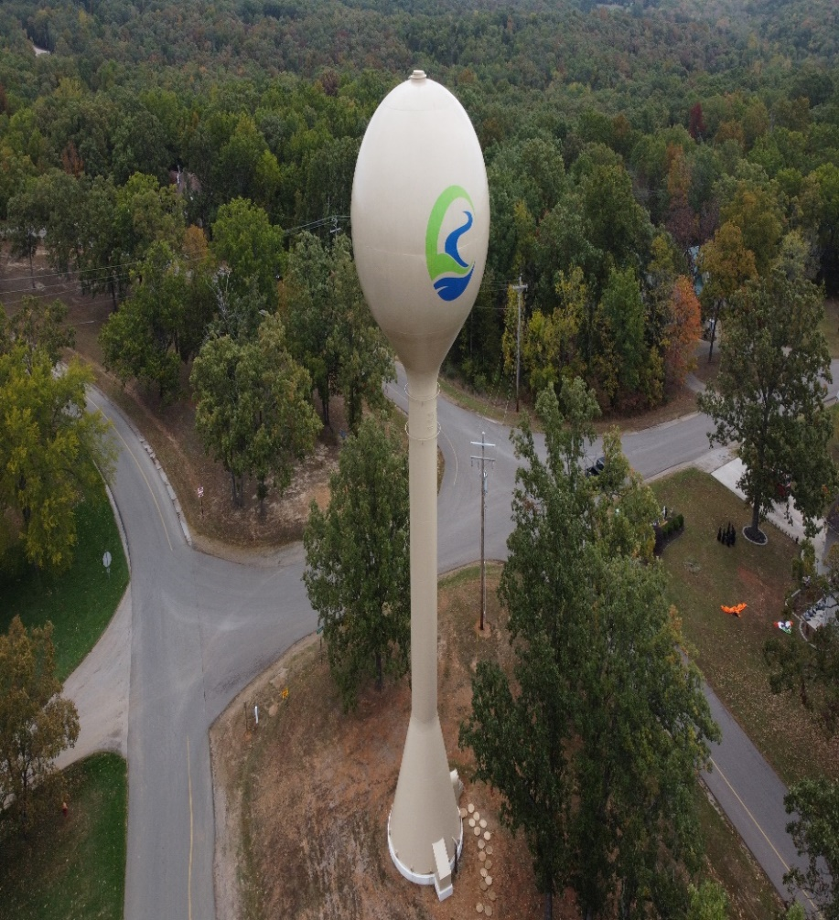
Future of Confluence Rivers
  Confluence Rivers continues to deliver on its mission: Invest in communities to ensure safe, reliable, and environmentally responsible water resources
  Confluence Rivers has invested over $29mm towards improving water and wastewater infrastructure in communities across Missouri
  Recently submitted first annual Capital Improvement Plan detailing Confluence’s intent to reinvest over $25mm in the next 5 years
  We will continue working with the Department of Natural Resources and the Public Service Commission to provide safe and reliable service to every community in Missouri

Slide 13
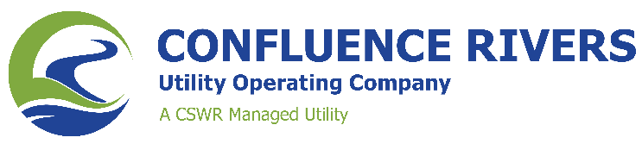
Thank You

